Slide 1
Text Recognition using EasyOCR and Streamlit
Presented by: V. Ramesh

Slide 2
Introduction
OCR (Optical Character Recognition) enables machines to extract and understand
text from images.
This project focuses on implementing OCR using EasyOCR and deploying it via Streamlit
for real-time use.
Applicable in automated data entry, license plate reading, document scanning, etc.

Slide 3
What is EasyOCR?
Open-source OCR library built on PyTorch
Supports 80+ languages including regional scripts
Uses deep learning for text detection and recognition
Accurate and easy to integrate into Python projects

Slide 4
What is Streamlit?
Open-source Python library for building web apps for ML/data projects
Quick to deploy with interactive widgets
Ideal for showcasing models like OCR without complex web development

Slide 5
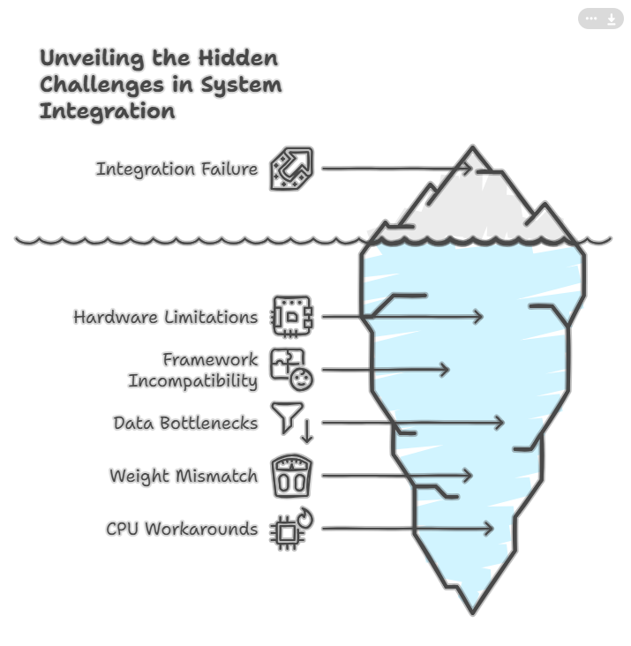
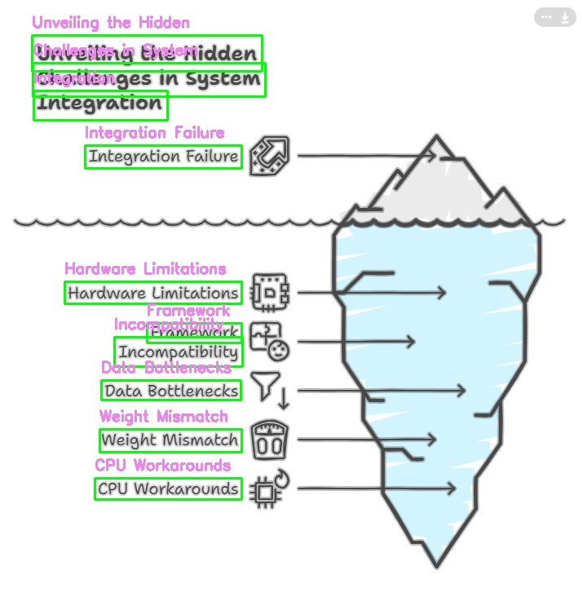
Output:
Sample input
Sample output

